Slide 1

OL 459 LED Sphere Calibration Standard

Slide 2
BACKGROUND
ABOUT OPTRONIC LABORATORIES, INC.
Optronic Laboratories, Inc. was established in 1970 by two eminent researchers at NIST (then NBS). Facilities were modeled after NIST, and Optronic Laboratories, Inc. achieved a worldwide reputation for excellence in light measurement and calibration.
For over 50 years we have been improving the way the world measures light with our spectroradiometers, integrating sphere systems, and calibration standards and services

Slide 3
What is the OL 459?
Tunable 5-channel LED source
Designed as a standard, reference, or calibration source
As many as 80 high power LEDs
Each channel current adjustable from 1.5% to 100%
Notes:
The OL 459 sphere source consists of a 6-inch diameter integrating sphere and display panel used to monitor and adjust the driving current and luminance of 5 separate, temperature-controlled LED channels with as many as 80 LEDs. The exit port has a 38.1 mm (1.5”) diameter exit aperture.
The OL 459 integrating sphere’s internal surfaces and baffles are coated with PTFE coating providing a highly diffuse reflectance over the visible and into the NIR wavelength range.
The user can select preset profiles from the display panel. Up to 10 profile settings can be saved in memory. The settings for these profiles can be selected prior to calibration of the unit at the factory or can be created / modified by the user.
Remote control of the source is facilitated by a USB interface allowing on/off control, driving current tuning, and uploading and downloading calibration factors and calibration profile information.

Slide 4
What qualifies a standard source?
Stability and repeatability
  Spectral radiance/ luminance
  Spectral profile/ shape
This comes from
  Precision Power supply
  Exceptional LED performance
  Efficient temperature management
  Stable luminance feedback
  NIST traceable calibration
Notes:
The OL 459 is a NIST traceable radiance/luminance calibration standard. A standard calibration source must be stable with a high level of repeatability. This ability comes from several factors. A precision power supply must be used to drive the current to high quality LEDs in order to ensure exceptional LED performance. Furthermore, the temperature of the operating LEDs as well as the monitoring photometer must be efficiently managed to ensure a stable output as well as an accurate feedback signal. The last factor that ensures the quality of a standard source is NIST traceability, which Optronic Laboratories maintains for all of our calibration standards.
The OL 459 can be calibrated for Luminance, correlated color temperature, and Spectral Radiance (400 nm – 1000 nm)
The customer defines the desired luminance, color temperature, and Spectral Radiance wavelength range (when applicable) to meet their needs. A maximum of 10 profiles can be saved to the device, each representing a potential calibration setting where these options can be requested, measured, then reported.

Slide 5
OL 459 Key Features
LED-based source
Notes:
The LEDs for the OL 459 are contained in 5 separate and temperature-controlled channels. The LEDs are seasoned and tested for performance. The channels consist of 2 blue, 1 green, 1 red and 1 red/NIR channels, each with individual different LEDs. These five channels produce a continuous spectrum from the visible to the NIR. There is a standard LED configuration, however other LED combinations can be used at the customer’s request.

Slide 6
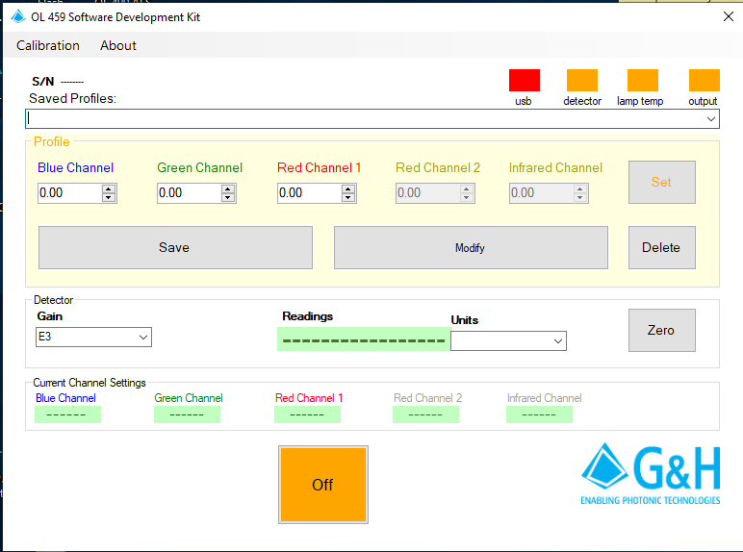

OL 459 Key Features
LED-based source
Application software provided
Notes:
The entire integrated unit can be controlled using the keypad and display screen. It can also be controlled remotely using the factory provided OL 459 software interface. The software is very user friendly and provides the user with total control over the unit. There is also a software development kit available that allows the user to control the unit using a selected coding platform.

Slide 7
OL 459 Key Features
LED-based source
Application software provided
5 independently tunable channels
Notes:
At the top of the software panel, the user can select from up to 10 saved spectral profiles. In addition, the driving currents for the 5 individual LED channels can be adjusted separately and selecting “Set” when finished to customize the spectral output.

Slide 8
OL 459 Key Features
LED-based source
Application software provided
5 independently tunable channels
Built-in monitor detector
Notes:
The unit has a built-in heated monitoring photometer who’s display can be seen in real-time. The gain of the photometer can be manually adjusted and the photometer reading can be zeroed when the unit and surrounding environment are stable to provide accurate luminance monitoring.

Slide 9
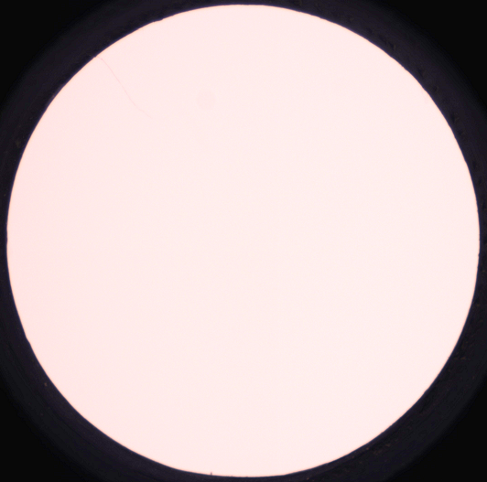
OL 459 Key Features
LED-based source
5 independently tunable channels
Application software provided
Built-in monitor detector
High spatial uniformity
+ 1%
Notes:
The OL 459 contains a 6” integrating sphere coated with PTFE with exceptional and uniform reflectivity throughout the visible and NIR spectrum. The radiating port has a 1.5” (38.1mm) diameter with a profile uniformity of + 1%.

Slide 10
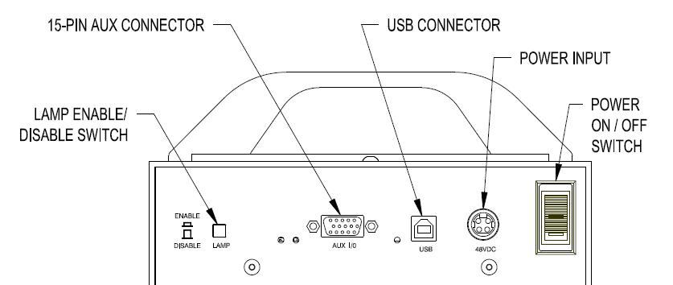
OL 459 Key Features
LED-based source
5 independently tunable channels
Application software provided
Built-in monitor detector
High spatial uniformity
Internal hour meter/tracker
Remote control via USB
Notes:
The OL 459 also has an internal hour meter to keep track of its usage as well as an easily accessible USB port on the rear of the unit facilitating remote operation via the factory provided software interface or the available software development kit.

Slide 11
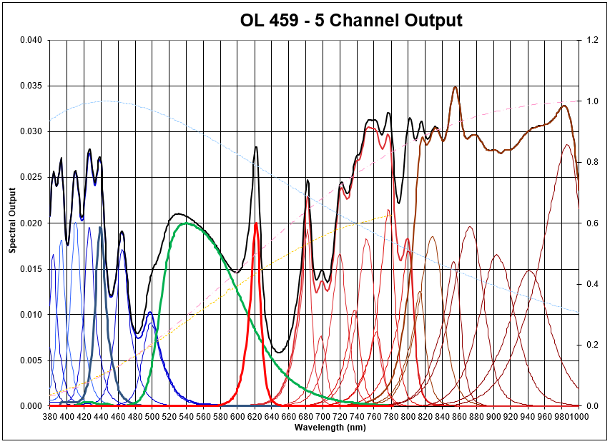
OL 459 Spectral Output
Notes:
The combination of up to 80 individual LEDs in the 5 channel (2 blue, 1 green, and 2 red) provide a programmable, broadband spectrum throughout the visible and NIR range. Within this broadband spectrum, individual spectral or color profiles can be programmed by manually adjusting the driving currents to each separate channel with up to 10 separate profiles can be stored in the unit’s internal memory.

Slide 12
OL 459 Specs
Sphere Size | 6.0 inches (15.2 cm) Diameter
Exit Port Aperture Size Diameter | 1.50 inches (38.1 mm)
Sphere Coating Reflectance | >98 % Reflectivity
Wavelength Range | 400 nm to 1000 nm
Sphere Luminance Monitor (Built-In) | Silicon detector with filtered
CIE photopic response
Uniformity | + 1%
Operating Temperature | 41º F to 104º F (5º C to 40º C)
Source Power Input | 48 VDC, 5.8 Amps
AC Power Input Communications Interface | 100-240 VAC, 50/60 Hz, 4.5 A USB
Dimensions | 11” L x 7.5” W x 9.75” H
Weight | 13.5 lbs (5.7 kg)
Notes:
The PTFE coating provides a >98% reflectivity over the OL 459’s entire wavelength range with the 6” diameter integrating sphere providing exceptional uniformity at the unit’s 1.5” port. The temperature-controlled Si monitor detector is temperature operated with a photopic filter for consistent luminance monitoring to ensure performance stability. The power supply is contained within this rugged unit making it completely integrated and its small footprint and light weight makes it incredibly versatile.

Slide 13
OL 459 Advantages
Reliable Performance
  Luminance stability: +0.5%
Wide range of LEDs for customization of spectral profiles
Suited for method or product development and routine calibration of inspection instruments at mass production facilities
  Weight: 13.5 lbs
  Dimensions 11” L x 7.5” W x 9.75” H
Notes:
The housing contains a controller circuit board with power input connector, lamp enable switch, and LED source status indicators. The controller circuit board provides power to each LED channel, with each channel powering multiple LEDs. The controller maintains a constant LED temperature, regardless of whether the lamps are enabled, providing enhanced stability over long periods of usage, ensuring a luminance uncertainty of only +0.5% and CCT uncertainty of +25K.
Up to 80 LEDs allows extensive customization of spectral profiles with the option to work with OLI to customize the spectral performance that meets the customer’s individual application.
The small footprint (less than a foot in all directions), the light weight of 13.5 lbs, and remote operating capability makes the OL 459 better suited for calibrating inspection instruments at mass production facilities, or other applications where physical access is limited.

Slide 14
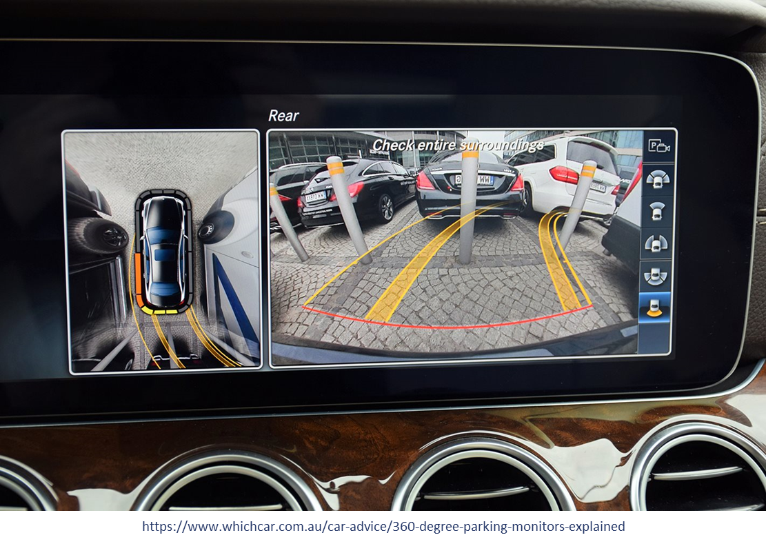
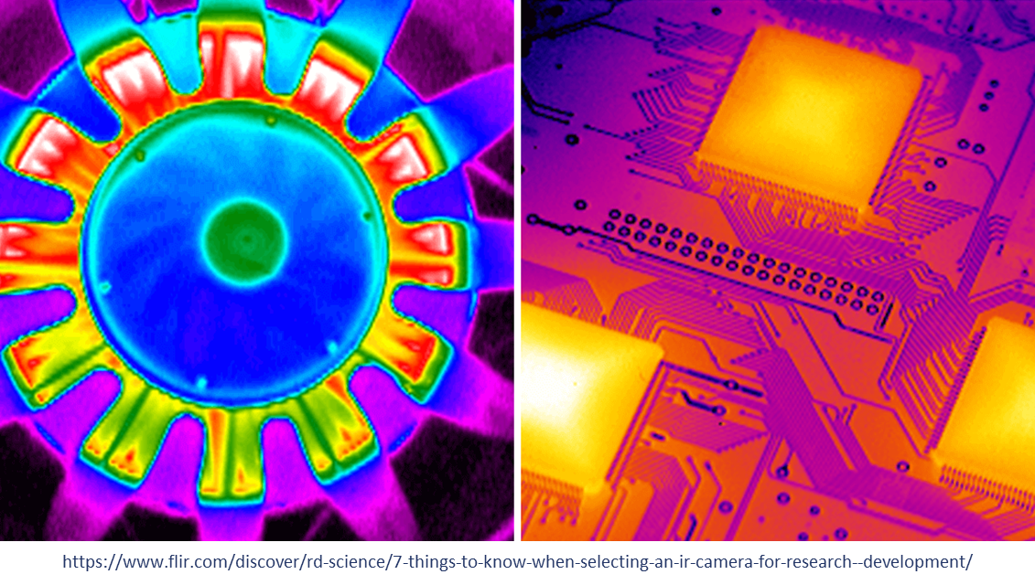
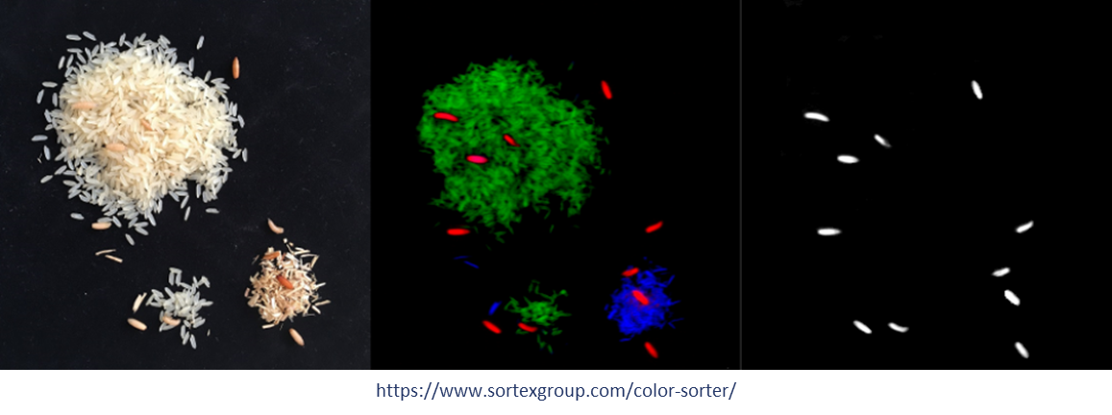
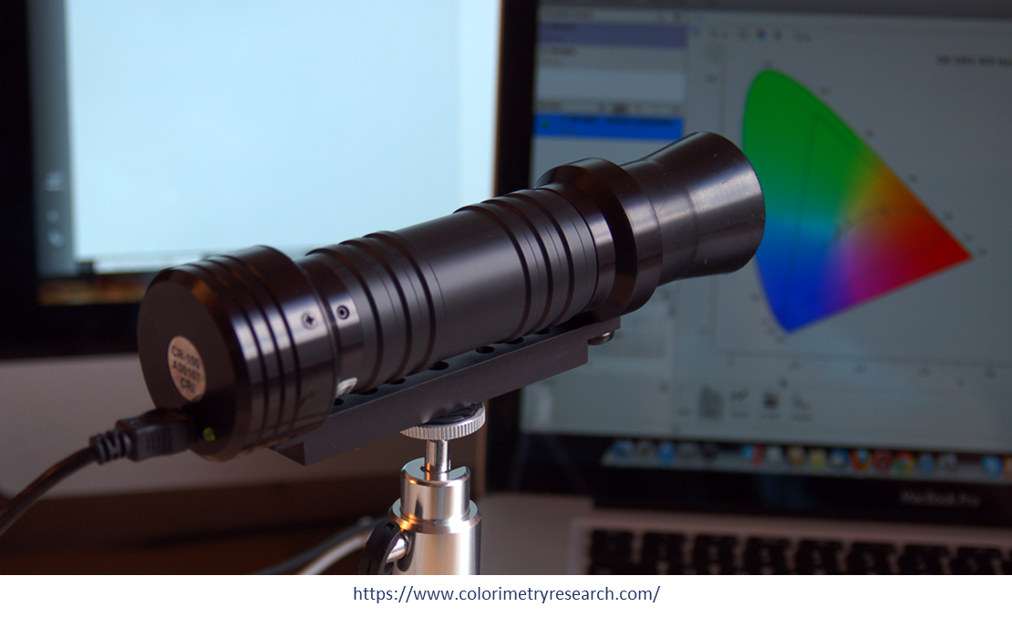
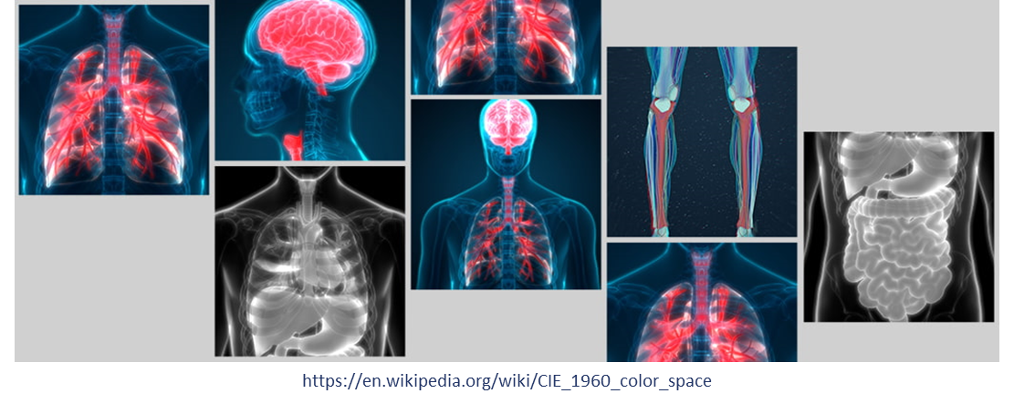
Applications
Camera and image sensor calibration
Photodiode detector responsivity characterization
Spectrum/Illuminant simulation
Diagnostic medical imaging
Technical and industrial photography
Notes:
Customizable spectral output aids to reduce calibration spectral mismatch in applications where accuracy is essential, such as camera/image sensor calibration or simulating individual illuminants. It’s small footprint and remote access makes the OL 459 a great fit for mass production applications.

Slide 15
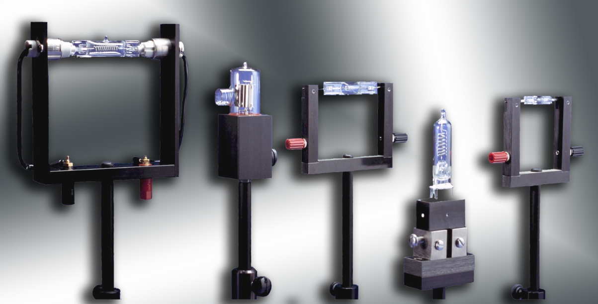
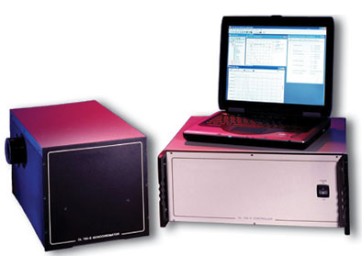
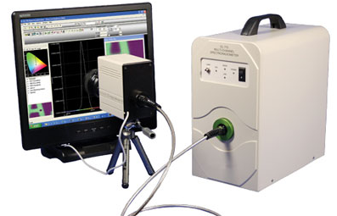
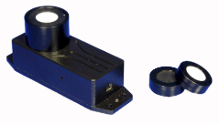
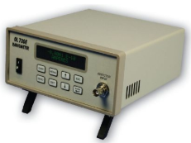
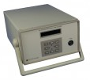
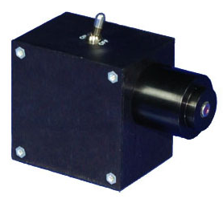
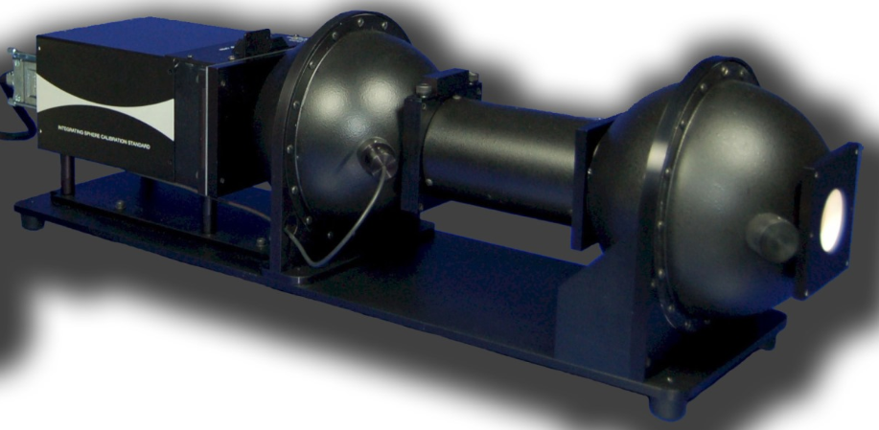
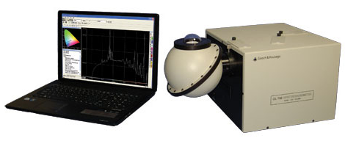
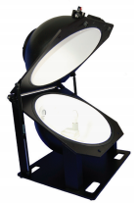
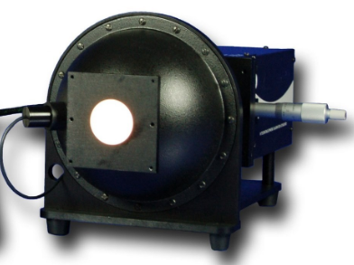
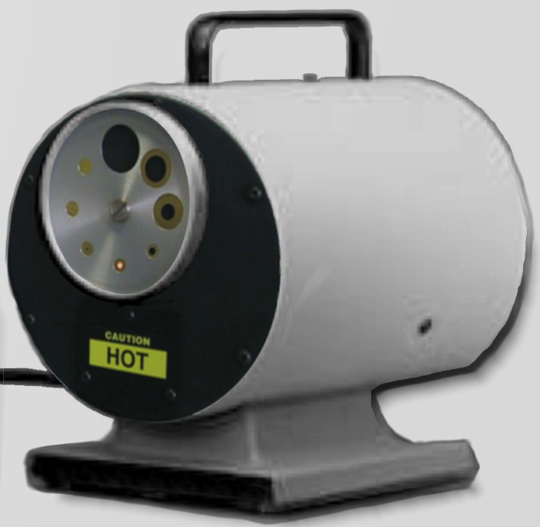
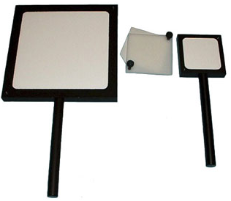
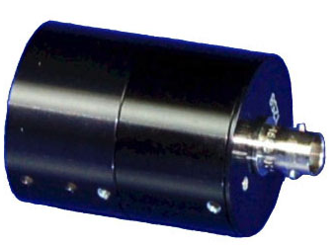
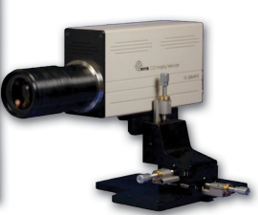
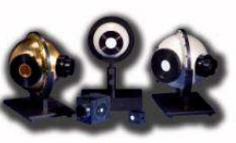
Other Calibration Options at OLI
Calibration Standards
Spectroradiometric Workstations
Accessories
Notes:
In addition to the OL 459, Optronic Laboratories provides an extensive collection of NIST traceable calibration standards for all applications in a variety of wavelength calibrations.

Slide 16
Contact Us
Chris Gordon – Product Scientist
  407-785-6017
  Chris.Gordon@optroniclabs.com
Notes:
If you have questions on how Optronic Laboratories can help you with your particular application needs, please do not hesitate to reach out to us.

